Slide 1
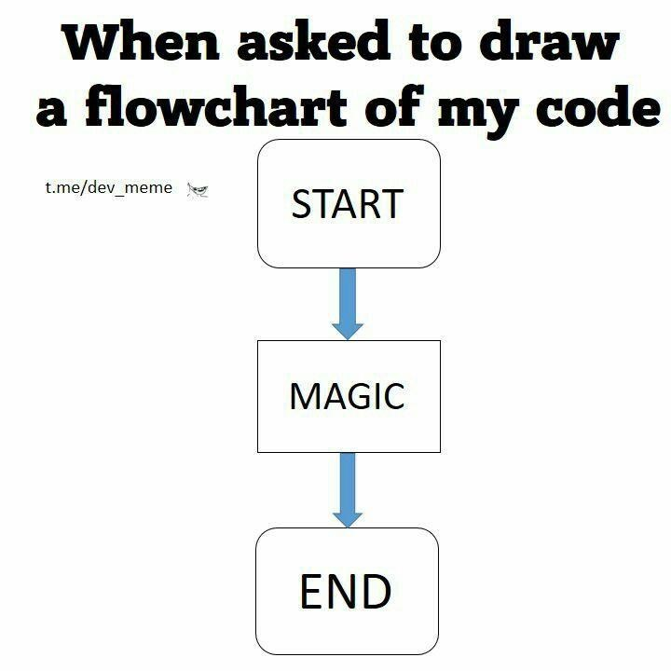
Kayla’s Coding Corner
(where Master’s students become magicians!)
Workshop #1: Overview & Dates/Times
01/25/2022

Slide 2
A couple things before we get started…

Slide 3
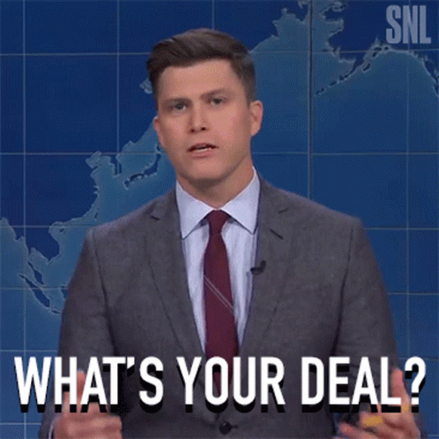
Have you used R before?
What would you like to use R for?
What do you see your relationship with R being in 5 years?
Notes:
Please ask me questions!! Zoom is weird..

Slide 4

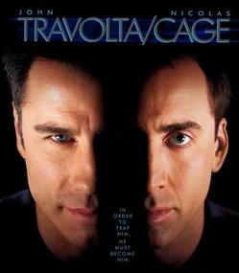



R vs. Other Point-And-Click-y Programs

Slide 5
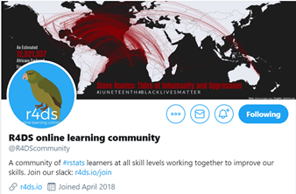
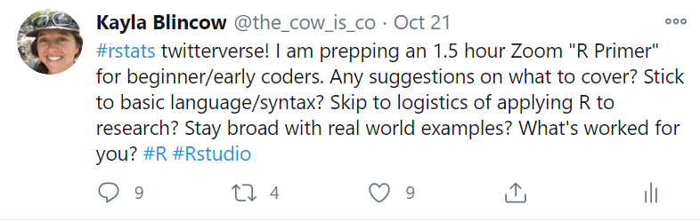
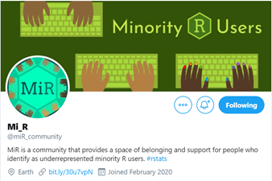
Why R is the coolest…
R is for free!
You can do everything in one program
Transparent, easily shareable, and reproducible analyses
Awesome community of folks who want to help you succeed!
  R Users Group
  #rstats

Slide 6
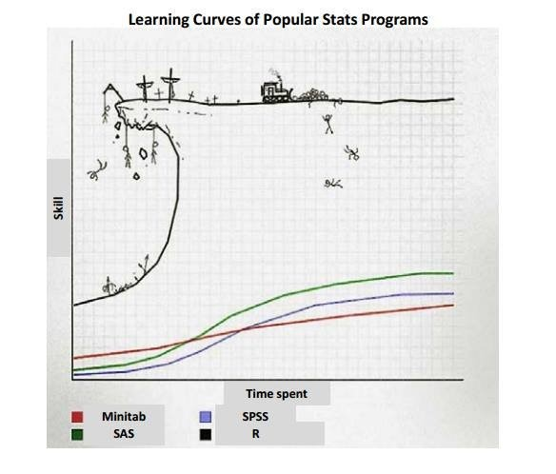
Learning R requires patience. And practice.
R is a language.
  There’s some vocabulary you’re going to have to learn
  There’s a (semi) steep learning curve
  The best way to learn is to do it
  Practice, practice, practice
You will get better! I promise!

Slide 7
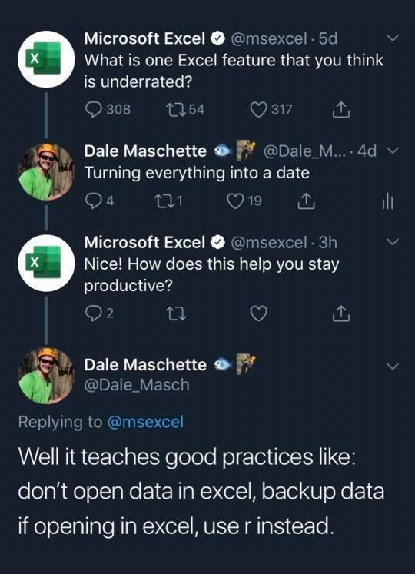
Dates and Times in R

Slide 8
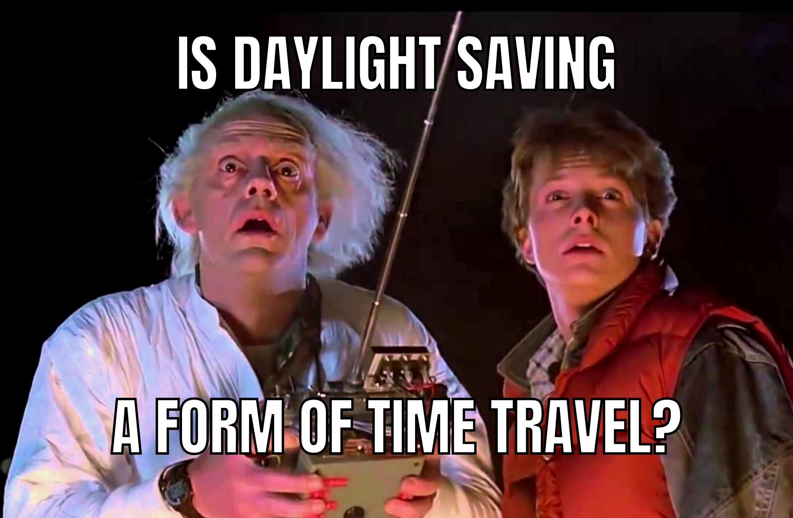
Why dates/times are so gosh darned annoying…
We have imperfect systems for tracking time
Writing dates/times is often ambiguous which is hard for computers
Yet, time is super important for almost all ecological questions! Especially telemetry!
Notes:
e.g. Not every year has 365 days
Time is a weird mix of social constructs and the earth spinning

Slide 9
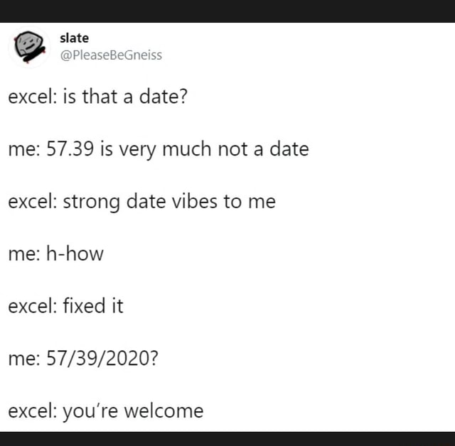
How R handles dates/time.
R will not automatically classify something as a date/time unless you tell it to
  Thank goodness!
Most common date/time classifying functions
  as.Date() – for dates only
  as.POSIXct() – for dates and times
  lubridate package – tidyverse’s answer to date/time issues

Slide 10

Switch to code!

Slide 11
Useful Links
Base R dates/times
  A Comprehensive Introduction to Handling Date & Time in R | R-bloggers
lubridate package
  16 Dates and times | R for Data Science (had.co.nz)

Slide 12
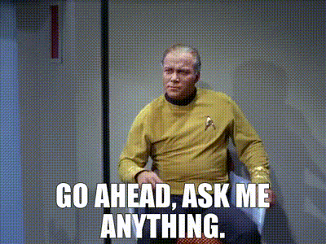
Open Question Time

